Slide 1
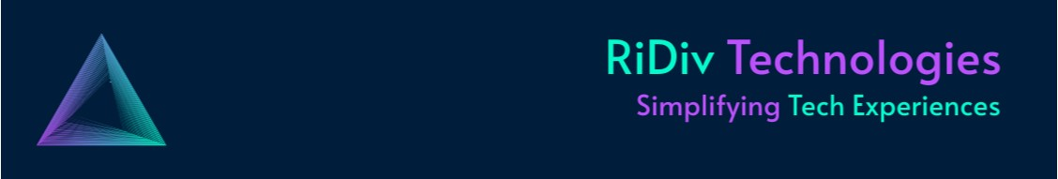
BUSINESS ANALYSIS REPORT
FOR OPEN AI TOOLS
OpenAI applications could revolutionize the education sector by offering personalized learning experiences and intelligent tutoring systems. Furthermore, in manufacturing, they could optimize processes, improve predictive maintenance, and enhance overall efficiency.
Healthcare and finance are another industries where OpenAI applications, such as advanced natural language processing for medical records or predictive analytics for financial markets, could have a substantial impact on efficiency, decision-making, and overall outcomes.

Slide 2

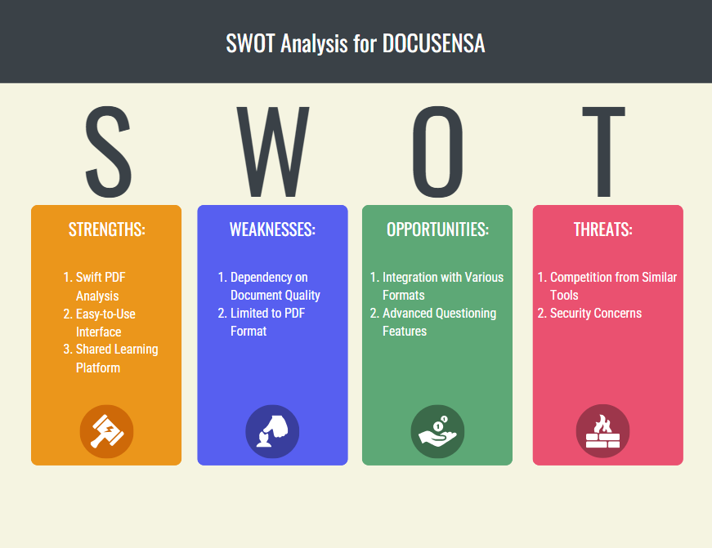
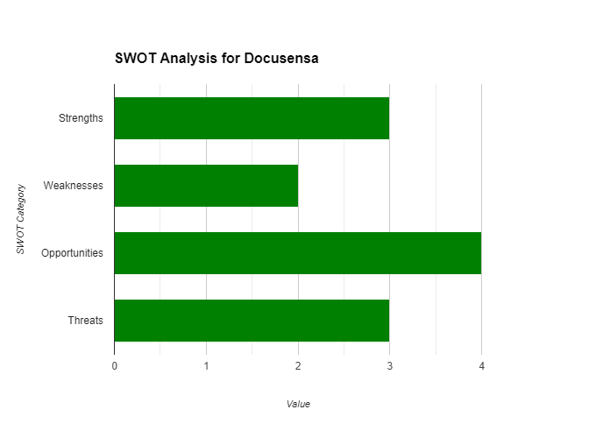
SWOT Analysis for Docusensa.ai
On a whole, Docusensa presents a promising tool for collaborative document analysis, but addressing limitations and staying ahead of evolving user expectations will be key to sustained success.

Slide 3
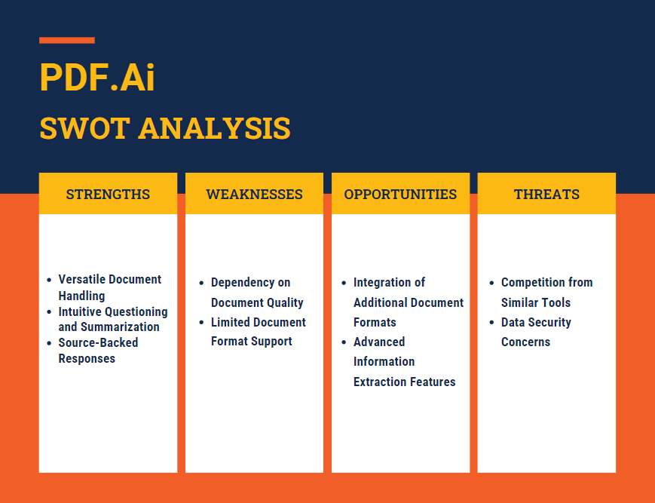
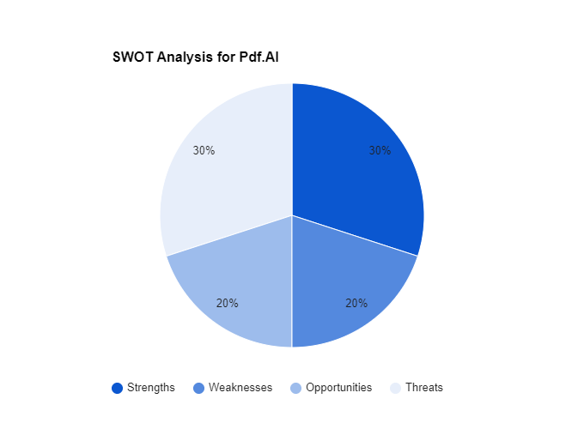
SWOT Analysis for pdf.ai
Pdf.AI exhibits strong document handling capabilities and user-friendly features. To stay competitive, addressing weaknesses and exploring new functionalities will be essential for long-term success.

Slide 4

User Persona: Online Learner in Higher Education
Name: Sarath Chandra
Background: Graduate Student
Age: 26
Occupation: Graduate Student
Field of Study: Computer Science
Learning Environment: Pursuing an advanced degree through an online learning platform.
Goals and Challenges:
Goal: Master complex topics in computer science and stay updated on the latest advancements in the field.
Challenge: Balancing a part-time job with coursework, struggling to efficiently comprehend extensive research papers and textbooks.
Key Benefits for Sarath:
Personalized Learning: Docusensa tailors explanations to Sarath's learning style, providing a personalized and adaptive learning experience.
Efficient Comprehension: By asking targeted questions, Sarath efficiently extracts key information from complex texts, enhancing overall understanding.
Overall Impact:
OpenAI applications in education empower Sarath to navigate the demands of higher education effectively, making learning more personalized, engaging, and aligned with individual academic goals.

Slide 5
Use cases of Open AI
Enhanced Learning in Online Computer Science Courses
Financial Report Analysis with Pdf.AI
Market Trend for an OpenAI application:
Education Industry:
Adoption Rates: The adoption of AI in education has been steadily increasing. With the rise of online learning platforms and the need for personalized education, OpenAI applications could see significant adoption, especially in higher education.
Technological Advancements: As AI technologies continue to evolve, the capabilities of OpenAI applications may improve, making them more appealing to educational institutions and learners.
Market Trends: Personalized learning, intelligent tutoring, and adaptive educational tools are growing trends. OpenAI applications align with these trends, suggesting a substantial market opportunity.
Presented by
DHULIPUDI VENKATA SATYA SAI RAKESH.
sairakesh228@gmail.com
Linkedin : https://shorturl.at/uAGJP
Github : https://github.com/sairakeshh

